Slide 1
Dynamic Programming

Slide 2
Introduction to Dynamic Programming
Dynamic programming is used where we have problems, which can be divided into similar sub-problems, so that their results can be re-used. Mostly, these algorithms are used for optimization. Before solving the in-hand sub-problem, dynamic algorithm will try to examine the results of the previously solved sub-problems.
So we can say that −
The problem should be able to be divided into smaller overlapping sub-problem.
An optimum solution can be achieved by using an optimum solution of smaller sub-problems.
Dynamic algorithms use Memoization.
Dynamic Programming is mainly an optimization over plain recursion. Wherever we see a recursive solution that has repeated calls for same inputs, we can optimize it using Dynamic Programming. The idea is to simply store the results of subproblems, so that we do not have to re-compute them when needed later.

Slide 3
How to solve a Dynamic Programming Problem ?
Dynamic Programming (DP) is a technique that solves some particular type of problems in Polynomial Time. Dynamic Programming solutions are faster than the exponential brute method and can be easily proved for their correctness. Before we study how to think Dynamically for a problem, we need to learn:
Overlapping Subproblems
Optimal Substructure Property

Slide 4
How to classify a problem as a Dynamic Programming Problem?
Typically, all the problems that require maximizing or minimize certain quantities or counting problems that say to count the arrangements under certain conditions or certain probability problems can be solved by using Dynamic Programming.
All dynamic programming problems satisfy the overlapping subproblems property and most of the classic dynamic problems also satisfy the optimal substructure property. Once, we observe these properties in a given problem, be sure that it can be solved using DP.

Slide 5
Tabulation vs Memoization
Prerequisite – Dynamic Programming, How to solve Dynamic Programming problems? There are two different ways to store the values so that the values of a sub-problem can be reused. Here, will discuss two patterns of solving dynamic programming (DP) problems:
Tabulation: Bottom Up
Memoization: Top Down

Slide 6
Fibonacci numbers
The Fibonacci numbers are the numbers in the following integer sequence. 0, 1, 1, 2, 3, 5, 8, 13, 21, 34, 55, 89, 144, ……..

Slide 7
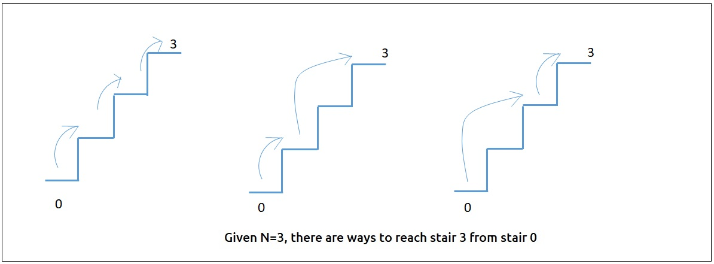
Climbing Stairs
Problem Statement: Given a number of stairs. Starting from the 0th stair we need to climb to the “Nth” stair. At a time we can climb either one or two steps. We need to return the total number of distinct ways to reach from 0th to Nth stair.

Slide 8
Frog Jump
Given a number of stairs and a frog, the frog wants to climb from the 0th stair to the (N-1)th stair. At a time the frog can climb either one or two steps.
A height[N] array is also given. Whenever the frog jumps from a stair i to stair j, the energy consumed in the jump is abs(height[i]- height[j]), where abs() means the absolute difference. We need to return the minimum energy that can be used by the frog to jump from stair 0 to stair N-1.

Slide 9
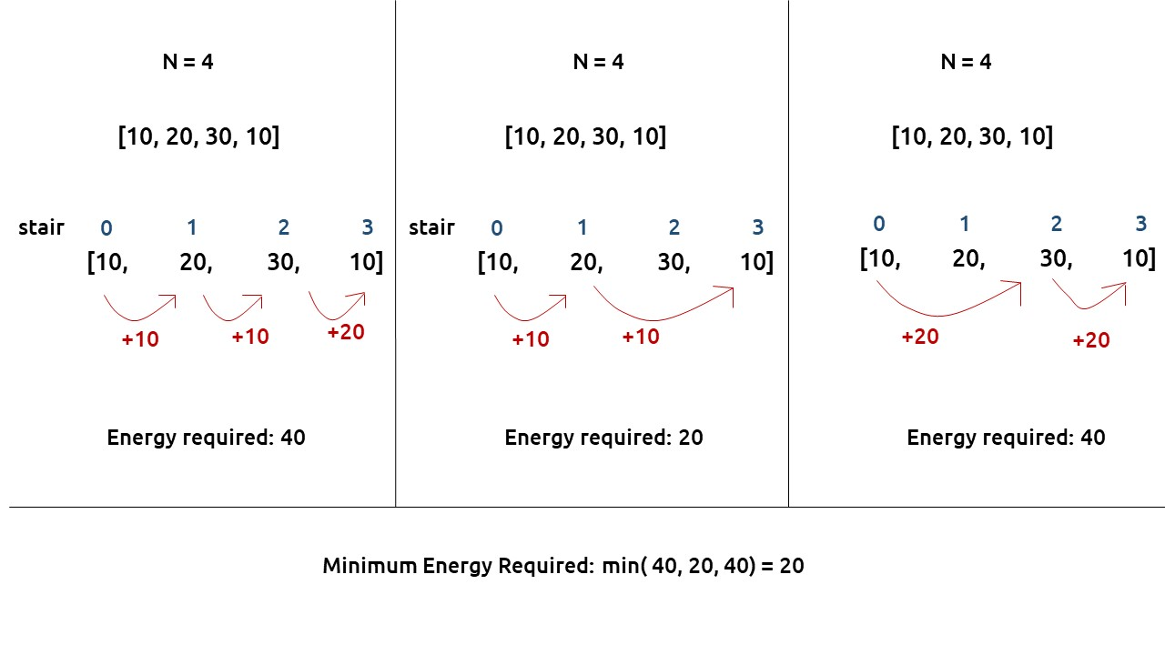

Slide 10
Frog Jump with k Distances
In the previous question, the frog was allowed to jump either one or two steps at a time. In this question, the frog is allowed to jump up to ‘K’ steps at a time. If K=4, the frog can jump 1,2,3, or 4 steps at every index.

Slide 11
Maximum sum of non-adjacent elements
Problem Statement:
Given an array of ‘N’ positive integers, we need to return the maximum sum of the subsequence such that no two elements of the subsequence are adjacent elements in the array.
Note: A subsequence of an array is a list with elements of the array where some elements are deleted ( or not deleted at all) and the elements should be in the same order in the subsequence as in the array.

Slide 12
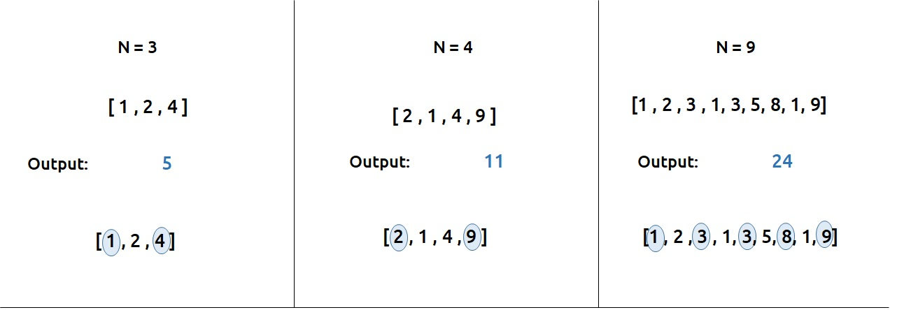

Slide 13
House Robber
A thief needs to rob money in a street. The houses in the street are arranged in a circular manner. Therefore the first and the last house are adjacent to each other. The security system in the street is such that if adjacent houses are robbed, the police will get notified.
Given an array of integers “Arr” which represents money at each house, we need to return the maximum amount of money that the thief can rob without alerting the police.

Slide 14
Grid Unique Paths : DP on Grids
Given two values M and N, which represent a matrix[M][N]. We need to find the total unique paths from the top-left cell (matrix[0][0]) to the rightmost cell (matrix[M-1][N-1]).
At any cell we are allowed to move in only two directions:- bottom and right.

Slide 15
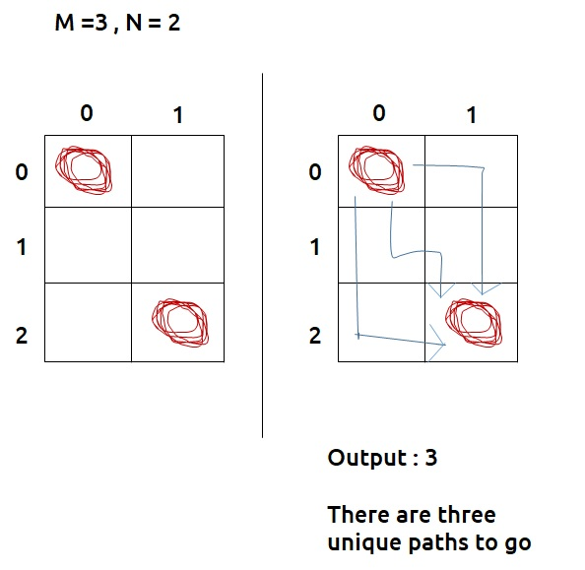

Slide 16
Minimum Path Sum In a Grid
Problem Description:
We are given an “N*M” matrix of integers. We need to find a path from the top-left corner to the bottom-right corner of the matrix, such that there is a minimum cost past that we select.
At every cell, we can move in only two directions: right and bottom. The cost of a path is given as the sum of values of cells of the given matrix.

Slide 17
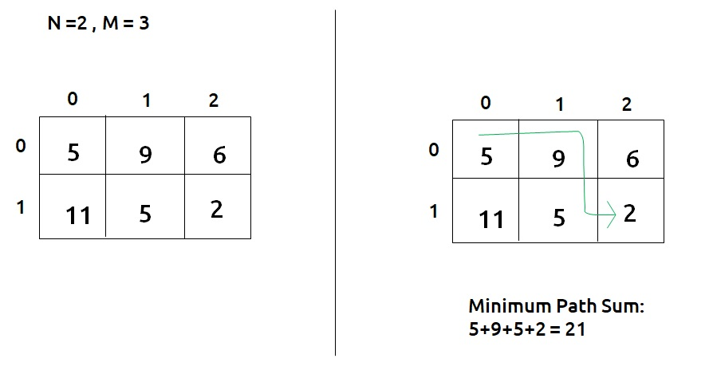

Slide 18
Subset sum equal to target
First, we need to understand what a subsequence/subset is.
A subset/subsequence is a contiguous or non-contiguous part of an array, where elements appear in the same order as the original array. For example, for the array: [2,3,1] , the subsequences will be [{2},{3},{1},{2,3},{2,1},{3,1},{2,3,1}} but {3,2} is not a subsequence because its elements are not in the same order as the original array.
We are given an array ‘ARR’ with N positive integers. We need to find if there is a subset in “ARR” with a sum equal to K. If there is, return true else return false.

Slide 19
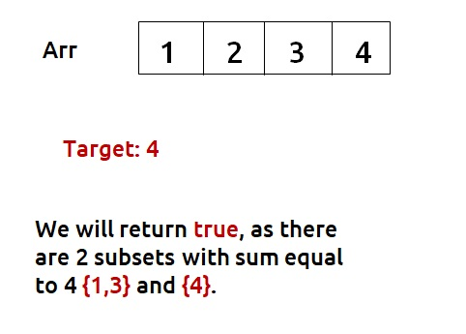

Slide 20
0/1 Knapsack
A thief wants to rob a store. He is carrying a bag of capacity W. The store has ‘n’ items. Its weight is given by the ‘wt’ array and its value by the ‘val’ array. He can either include an item in its knapsack or exclude it but can’t partially have it as a fraction. We need to find the maximum value of items that the thief can steal.

Slide 21
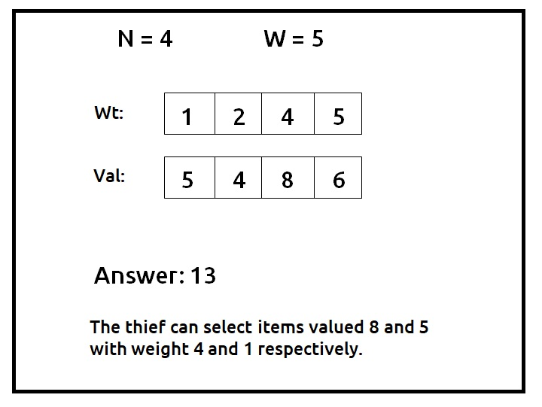

Slide 22
Unbounded Knapsack
A thief wants to rob a store. He is carrying a bag of capacity W. The store has ‘n’ items of infinite supply. Its weight is given by the ‘wt’ array and its value by the ‘val’ array. He can either include an item in its knapsack or exclude it but can’t partially have it as a fraction. We need to find the maximum value of items that the thief can steal. He can take a single item any number of times he wants and put it in his knapsack.

Slide 23
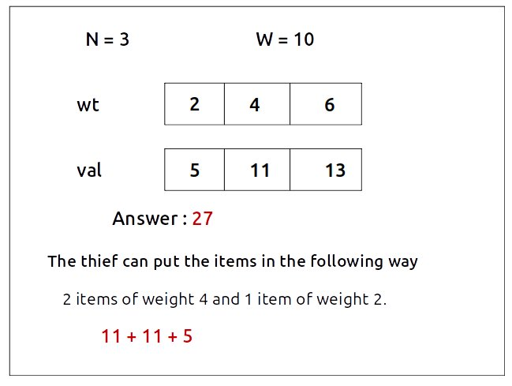

Slide 24
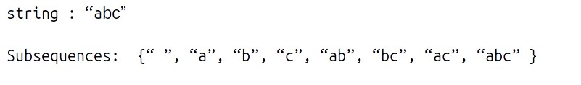
Longest Common Subsequence
A subsequence of a string is a list of characters of the string where some characters are deleted ( or not deleted at all) and they should be in the same order in the subsequence as in the original string.
For eg:
Strings like “cab”,” bc” will not be called as a subsequence of “abc” as the characters are not coming in the same order.
Note: For a string of length n, the number of subsequences will be 2^{n}.
Now we will look at “Longest Common Subsequence”. The longest Common Subsequence is defined for two strings. It is the common subsequence that has the greatest length.

